Slide 1


Detailed Design Generator Tool
More Lives Saved
More Life Lived
Ardeleanu Lucian
RBE

Slide 2
Brief Introduction
Detailed Design Generator Tool is an internal tool created by the RBE team that aims to generate the detailed design file obtained based on certain inputs.
At the base of this tool are several tools run from the main Python script, each tool having a well-defined role.
The result obtained will be a Word document (docx extension) in which you will find various chapters, each chapter presenting a certain type of parsed date.

Slide 3
The running mode of entire tool
One of the modes of operation of this tool is the mode of operation based on c_template files which involves the creation of c_template files which will be the basis for creating source code files.
These c_template files will contain a code similar to pseudocode, their purpose being functions in the respective software component.
In order to exemplify this mode of operation, an example module has been created that contains the c_template files associated with this module.
These c_template files will also be in the folder where the project source code files will be located ( S:\Components\Application\Component_Name\Design\Template ).

Slide 4
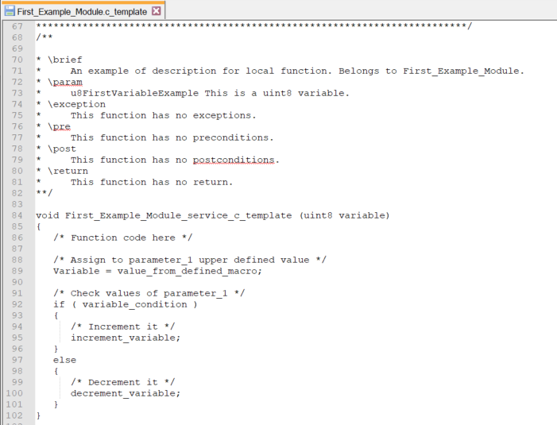
The running mode of entire tool
As can been seen, these files will have the extension c_template, and after writing them and generating the design document, they can be easily modified into c source files code.
Both comments (written according to certain doxygen compliant rules) and certain portions of code will be parsed from the c_template file.

Slide 5
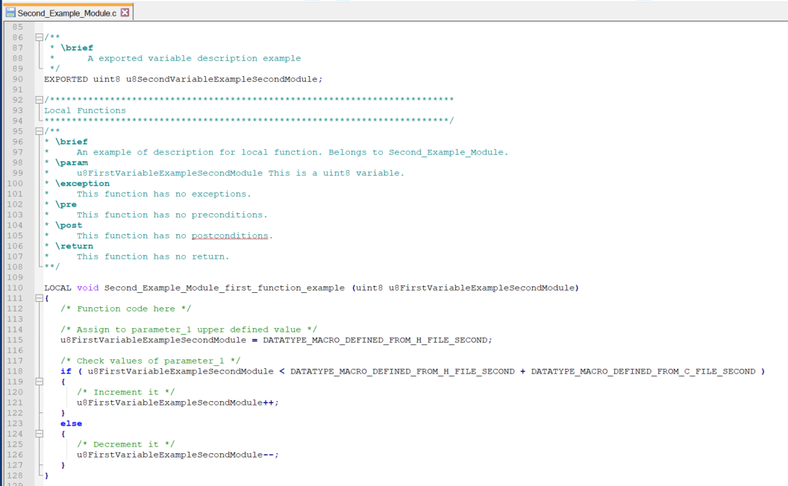
The running mode of entire tool
The second mode of operation of the tool involves the direct parsing of the source code files c.
As in the case of c_template files, the input files WILL HAVE TO CONTAIN WRITTEN COMMENTS ACCORDING TO DOXYGEN RULES.
In order to exemplify both modes of operation, 2 template software components were created: First_Example_Module and Second_Example_Module.

Slide 6
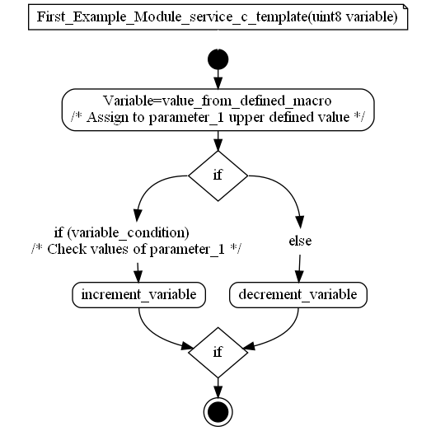
Tools used by Detailed Design Generator
Several auxiliary tools were used to generate the final report, namely:
doxygen - is a tool used in parsing comments added according to a certain format over each type of data in the source code. The doxygen with a project was configured in the Tools folder of the script, no need to reconfigure it from 0.
Graphviz - is one of the doxgen plugins necessary to make the connections between the code and the graphic components made. No need to configure this plugin.
mandoc - is a tool necessary for parsing the output from doxygen. This tool takes the input man3 files from the doxygen output and at the output it will display in the console the parsed data from the given input.
Moritz - is a doxygen plugin that aims to parsing the source code given at the input in various flowchart graphics of the source code.

Slide 7
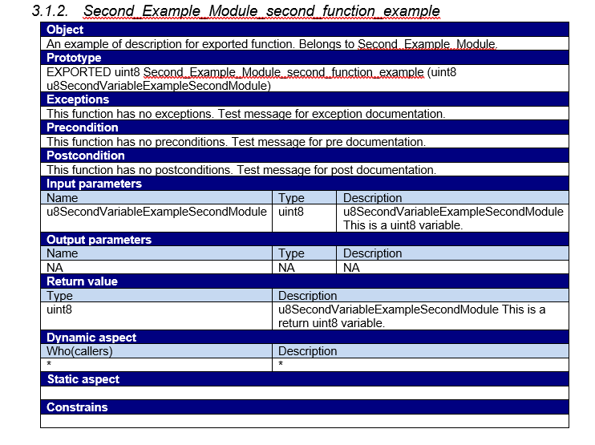
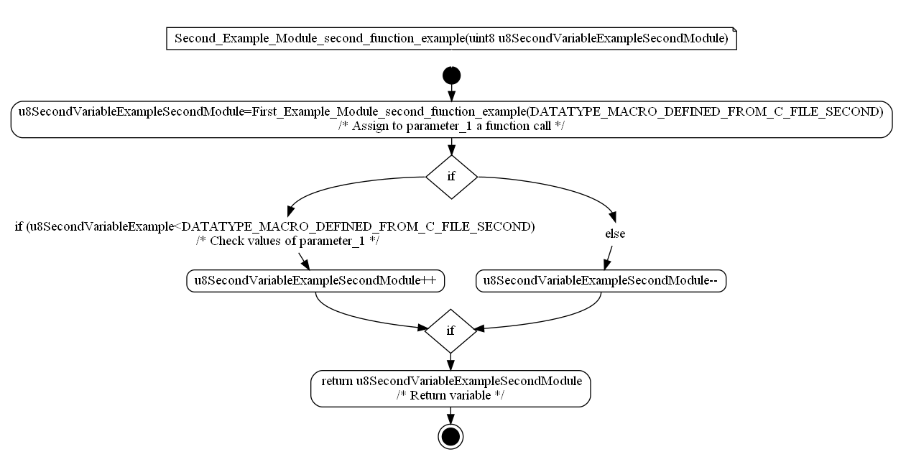
Tools used by Detailed Design Generator

Slide 8
Parsed Data Types
Detailed design tool can parse several types of data in the generated document, namely:
functions - this tool will parse each function in a table that will contain essential information for the purpose of that function as well as the graph exported from Moritz with the flowchart of that function. Not all functions can have graphics, so if graphics cannot be generated for a particular function, the tool will notify the user in the console of those functions for which no graphics have been generated. For functions, a table will be created at the top of the document that will assign each function a certain requirement.
variables - for each variable that will have a comment defined as the one in the template components, a table will be generated with the description of the variable as well as its type.
macros - for each defined macro that will have a comment like the one in the template components, a table will be generated with the description of the respective macro.
structures - each structure will be described in the document through a table that will contain the description of the respective structure as well as of the component members defined in the structure.

Slide 9
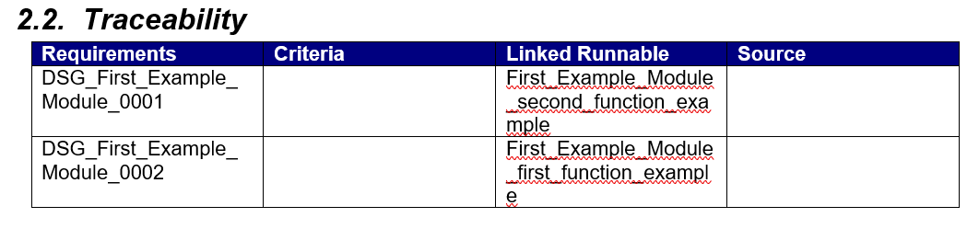
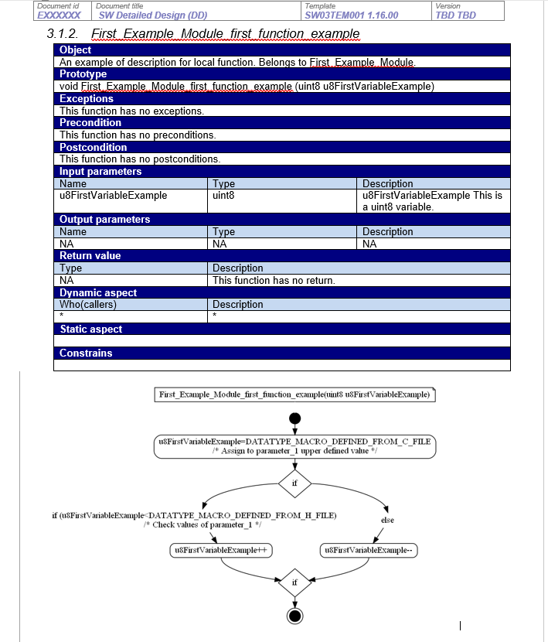
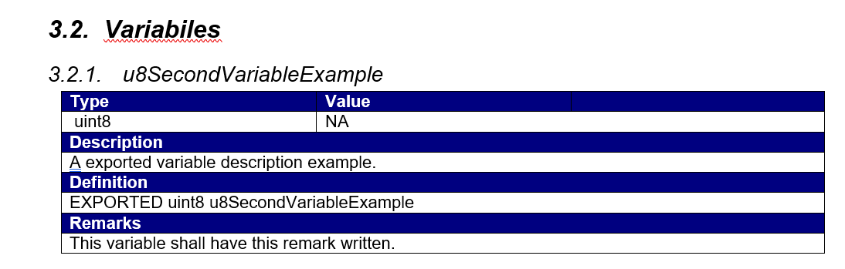
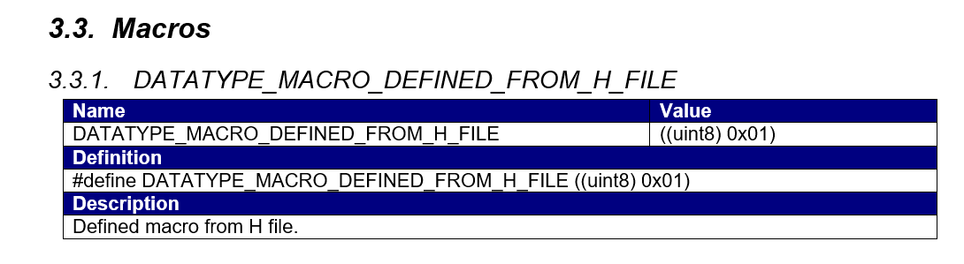
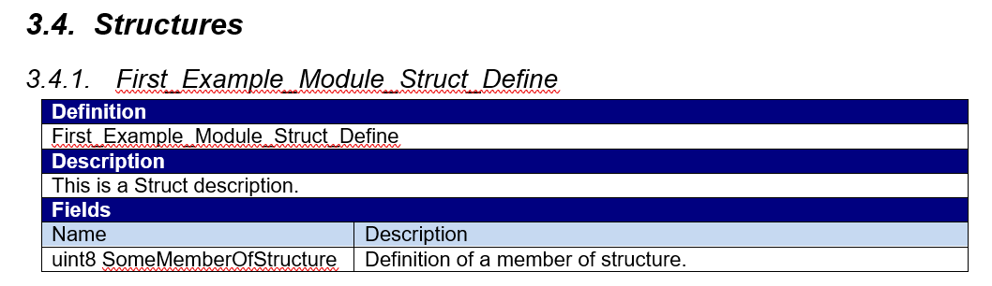
Parsed Data Types

Slide 10
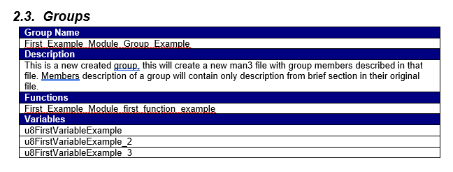
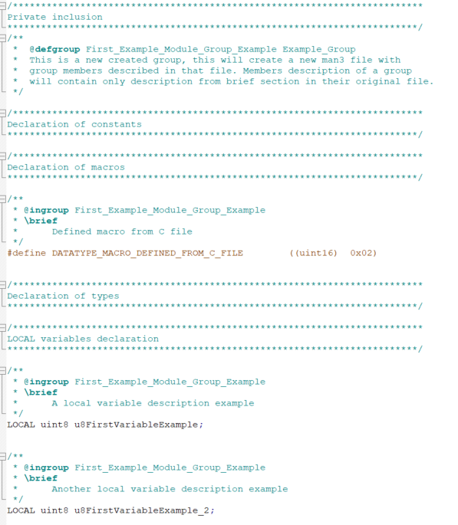
Parsed Data Types
The Detailed Design generator tool can also generate a table that will contain certain types of data defined as belonging to a certain group.
These groups must be defined in the source code (either c_template file or .c and .h file).
It is necessary to first define the group and then specify the membership of each type of data in that group.

Slide 11
Recommendations
Prior to running the script on a certain software component, it is recommended to verify that all the comments added in code is according to those in the created example modules. Otherwise, there is a possibility that the document generated does not contain accurate data or its document is generated wrong.
It is absolutely necessary for S: Drive to be mapped during runtime of this tool.
It is recommended that the template document does not change, or if it is even necessary to change it, pay attention to modify also certain chapters and paragraphs in the script (where a certain paragraph is searched ).
It is absolutely mandatory that the Tools folder is next to the Tool's script ( exe file ) of the tool.

Slide 12

Saving More Lives

